Slide 1
Detecting Melanoma using a Convolutional Neural Network Architecture
Kevin Genereux, Matthew Giorno, Peter Sertic
Advisor: Dr. Rachid Benlamri

Slide 2
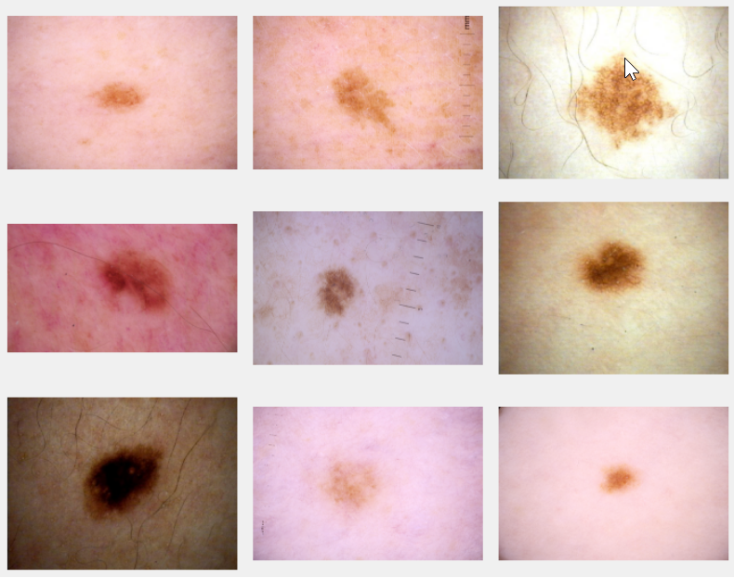
Introduction
Caused due to damage to melanocytes.
Skin cells grow uncontrollably and do not push old cells to the surface to fall off
Locations: legs, arms, neck, back
Causes: genetic factors, Ultraviolet (UV) Radiation
Figure 1: A random sample of melanoma images from the dataset.
2

Slide 3
Motivation
Accounts for 75% of skin cancer deaths; skin cancer is the most prevalent form of cancer.
Since 1973, the incidence rate of melanoma has risen from ~6 per 100k to ~17.5 per 100k in 2002^{[1]}.
Melanoma is treatable if diagnosed early^{[2]}. The survival rate is 90% if diagnosed in the local stage^{[1]}.
If left undiagnosed the survival rates drop drastically. 62% survival rate in the regional stage and 15% distant stage.
3

Slide 4

Research Question and Hypothesis
Question:
Can melanoma be accurately detected using deep learning models.
Hypothesis:
Models using a Convolutional Neural Network (CNN) architecture can be trained to be effective at binary classification (malignant or benign).
Prediction:
An automated system may be developed that can detect melanoma with comparable accuracy to qualified dermatologists.
Quality Measure:
Primarily AUC Score.
4

Slide 5
Equipment
Kaggle Kernels
GPU computing service provided by Kaggle
Nvidia Tesla P100, 16GB of memory
9.3 teraflops of single-precision calculations
CUDA 9.2.148 / cuDNN 7.4.1
Limited to six hours of execution time per session.
Lakehead University Compute Center
No time restrictions on testing final models
5

Slide 6
Environment
Python
Offers simple and readable code syntax to rapidly develop complex CNN models.
Wide variety of deep learning libraries.
Python Libraries
Keras for simple models.
TensorFlow & PyTorch for complex models.
Android
Develop mobile application.
6

Slide 7
Challenges
Various skin lesion manifestations (colour, texture, shape).
Severely imbalanced dataset.
Dataset noise (hairs, veins, bubbles).
Switching between compute platforms.
7

Slide 8
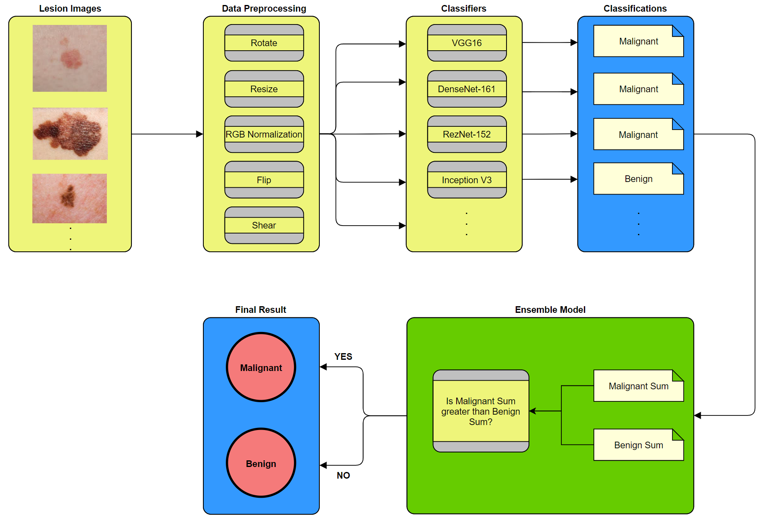
Methodology Overview
8
Figure 2: An overview of the methodology.

Slide 9
Methodology: Dataset
Provided by International Skin Imaging Collaboration (dataset collected from six universities)
Each skin lesion image also has other contextual information (ie. patient ID, gender, age, anatomical location, diagnosis)
Each patient may have multiple records.
2,746 unique patients.
44,108 images of various pixel dimensions (108 GB of memory)
98.36% of records are classified as benign.
9

Slide 10
Methodology: Data Preprocessing
Resize images
Raw images are in different dimensions.
Smaller images may lead to few features being learned (underfitting)
Larger images may lead to too many features being learned (overfitting)
Data Augmentation
Artificially add noise to create more robust dataset.
Examples: rotations, horizontal/vertical shifts, zooming, flipping, shear, normalizing RGB values.
10

Slide 11
Methodology: Model Construction I
CNN Architectures
Basic Architecture: VGG16
Complex Architectures: ResNet-152, InceptionV3, DenseNet-161
Convolutional Layers
Adjust type and number of hidden layers.
Batch Size
Indicates how often the weights are adjusted during backpropagation.
Weight Initialization
Provide best ‘initial guess’ at weights for quicker convergence.
Number of Nodes
Too few nodes may lead to underfitting; too many nodes may lead to overfitting.
11

Slide 12
Methodology: Model Construction II
Loss Function
Misclassifying melanoma instances should be penalized much more severely.
Optimizers & Learning Rate Annealing
Apply various optimizer to adjust node weights and minimize loss function.
Apply different learning rates to determine optimal rate of convergence.
Examples: RELU, Stochastic Gradient Descent, RMSProp
Regularization
Use different dropout rates for different layers to activate/deactivate nodes.
Ensemble Classifier
Combine results of top performing models using majority voting.
12

Slide 13
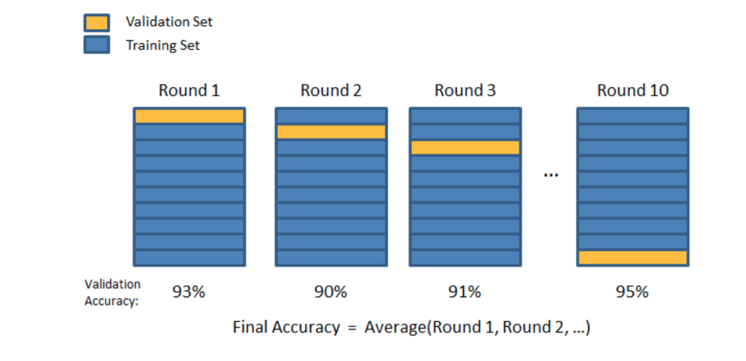
Methodology: Evaluation I
Stratified K-Fold Cross Validation (each hold-out will have equal number of malignant instances)
Figure 3: Illustration of dataset being partitioned using K-Fold Cross Validation.
13

Slide 14





Methodology: Evaluation II
Primary Metric
AUC Score (area under an ROC Curve).
Metric used to compare performance in Kaggle competition.
Other Metrics
Accuracy, Precision, Sensitivity, Specificity, F1 Measure.
Compare to related research papers.
Metric | Formula | Description
Accuracy |  | Proportion of correct patient predictions to total number of patients.
Precision |  | Proportion of patients correctly predicted to have melanoma to patients predicted to have melanoma.
Sensitivity |  | Proportion of patients correctly predicted to have melanoma to patients diagnosed with melanoma.
Specificity |  | Proportion of patients correctly predicted to not have melanoma to patients diagnosed without melanoma.
F1 Measure |  | Harmonic mean between precision and recall.
Table 1: Model metrics for accuracy, precision, sensitivity, specificity,
and F1 measure.
14

Slide 15
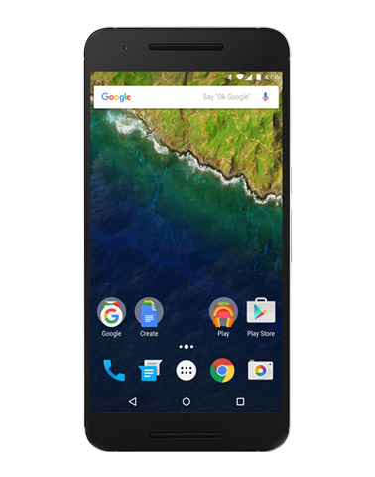
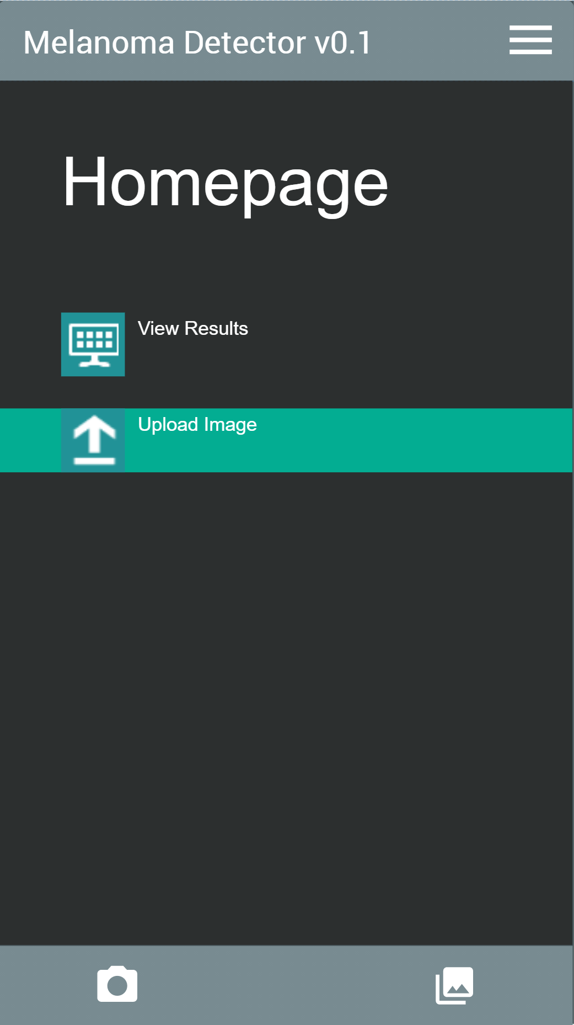
Methodology: Application
Mobile application (Android) which can be used to capture and upload images of skin lesions.
Images are sent to a server^{[3]} which will process them through the ensemble model and return results as to whether the lesion is melanoma or not.
Will be developed if time permits.
If time further permits:
User can create an account which they will upload photos to.
Account stores past uploaded skin lesion photos along with their classification.
Figure 4: Example of what first application prototype may look like.
15

Slide 16
Agile Lifecycle Model
Adaptive to changing requirements in design and specification.
Consists of multiple increments where features are incrementally added.
Objectives/requirements are analyzed and potential risks are evaluated at start of each increment.
Rapidly develop functioning models to present to client and receive feedback.
16

Slide 17
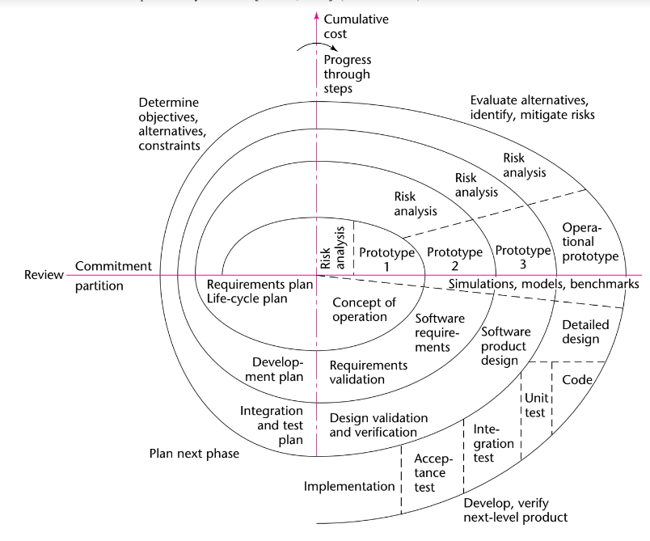
17

Slide 18
Project Milestones
Proof of Concept Model
Develop rudimentary model without any optimizations.
Integrate Model and Preprocessing Techniques
Add data preprocessing techniques.
Optimize Simple Models
Apply optimization techniques to simple models.
Complete Complex Models
Apply learned parameters from simple models to complex models using transfer learning.
Develop Ensemble Model
Combine results of top performing models using majority voting.
Develop Mobile Application (if time permits)
User inputs skin lesion image and receives diagnosis.
18

Slide 19
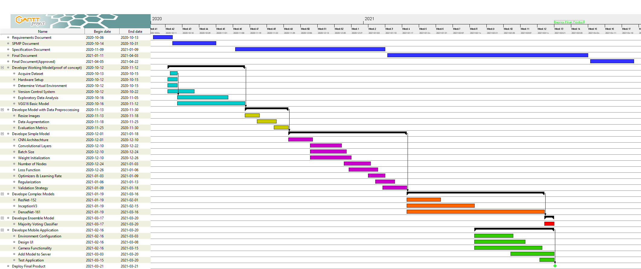
Gantt Chart
19

Slide 20
Functional Requirements
Input Requirements
Skin lesion image
Registration form data *
Login information *
Computational Requirements
Operations described in Model Construction section.
Output Requirements
Medical diagnosis
Melanoma general information *
Login display *
Data Requirements
Skin lesion image
Login credentials *
Contextual information *
Contact information *
* Denotes additional requirements if time permits.
20

Slide 21
Non-functional Requirements
Response Time
Individuals must be able to receive quick diagnosis.
<5 minute response time.
Storage
Dataset for training models, patient data, application code.
256GB memory.
Reliability
Server failure could be critical in preventing user from receiving diagnosis.
Uptime of 99.999+%
Privacy and Security
Encrypted communication between phone & server.
Sanitized user inputs to prevent SQL injection.
21

Slide 22
Duration Analysis I
Attribute | Value | Attribute | Value | Attribute | Value
Required software reliability | High (1.11) | Volatility of the virtual machine environment | N/A | Virtual machine experience | N/A
Size of application database | N/A | Required turnabout time | Low (0.94) | Programming language experience | Nominal (1.00)
Complexity of the product | Nominal (1.00) | Analyst capability | Low (1.19) | Application of software engineering methods | High (0.91)
Run-time performance constraints | Nominal (1.00) | Applications experience | Nominal (1.00) | Use of software tools | High (0.91)
Memory constraints | Nominal (1.00) | Software engineer capability | Low (1.17) | Required development schedule | Low (1.08)
22

Slide 23
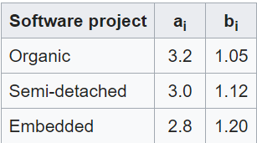
Duration Analysis II
Small team size
Previous experience with the technology
Problem has been solved in the past
KLOC Estimate: 2.6
Project Type: Organic
ai: 3.2
bi: 1.05
Estimated effort: 11.35 person-months
EAF = (1.11)(1)(1)(1)(0.94)(1.19)(1)(1.17)(1)(0.91)(0.91)(1.08) = 1.3
23

Slide 24
Application Areas
General users for quick screening tool before medical intervention.
Particularly beneficial for those without immediate access to a dermatologist.
If released to app store, would be available for free to maximize accessibility.
Dermatologists could leverage tool to aid in their melanoma diagnoses.
24

Slide 25
Alternative Products
UMSkinCheck: Mobile application which allows for photos of lesions/moles to be uploaded and tracked over time. Provides informational videos and literature to the user regarding skin cancer and can help locate a skin cancer specialist. Available on android or apple app store.
MoleMapper: Allows users to upload and track images of moles over time. Reminds users to check for moles regularly. Photos and surveys may be sent to researches for analysis.
Miiskin: Subscription service which allows photos of moles to be uploaded and tracked over time. Helps users keep a regular schedule for self skin examinations.
Mole Scope: Hardware/Software solution involving a camera attachment for your mobile device that allows you to take macro shots. Images are stored and tracked overtime and can be sent to a dermatologist. Integrated with DermEngine, a dermatology platform.
SkinVision: Software which allows you to take photos of lesions and upload to a server which will respond as to whether or not it is high or low risk.
25

Slide 26
Works Cited
[1] Berwick M, Wiggins C. The current epidemiology of cutaneous malignant melanoma. Front Biosci. 2006 May 1;11:1244-54. doi: 10.2741/1877. PMID: 16368510.
[2] J. Yang, F. Xie, H. Fan, Z. Jiang and J. Liu, "Classification for Dermoscopy Images Using Convolutional Neural Networks Based on Region Average Pooling," in IEEE Access, vol. 6, pp. 65130-65138, 2018, doi: 10.1109/ACCESS.2018.2877587.
[3] P. B. C. Castro, B. Krohling, A. G. C. Pacheco and R. A. Krohling, "An app to detect melanoma using deep learning: An approach to handle imbalanced data based on evolutionary algorithms," 2020 International Joint Conference on Neural Networks (IJCNN), Glasgow, United Kingdom, 2020, pp. 1-6, doi: 10.1109/IJCNN48605.2020.9207552.
26

